Slide 1
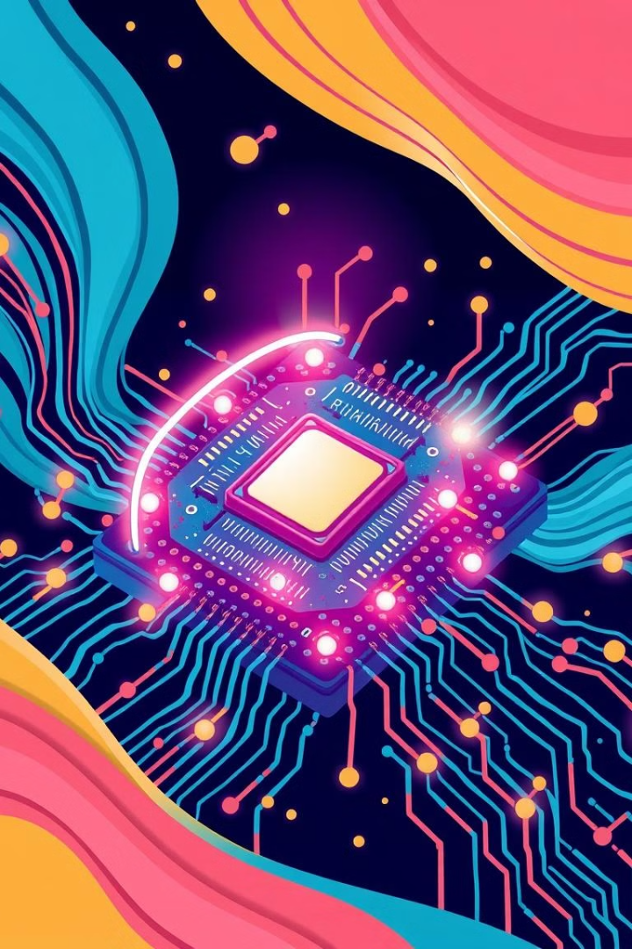
Quantum Computing: The Next Frontier in AI
A revolution in computation and artificial intelligence.
22071A3237 – M Thoran Chandra
22071A3258 – Tejasree Lokireddy

Slide 2
Introduction to Quantum AI
Bridging Quantum Computing and Artificial Intelligence.
Classical limitations
Quantum speedup
Synergistic potential
Classical computing struggles with complex AI tasks.
Quantum computing offers exponential speedup.
Quantum algorithms enhance AI models.

Slide 3
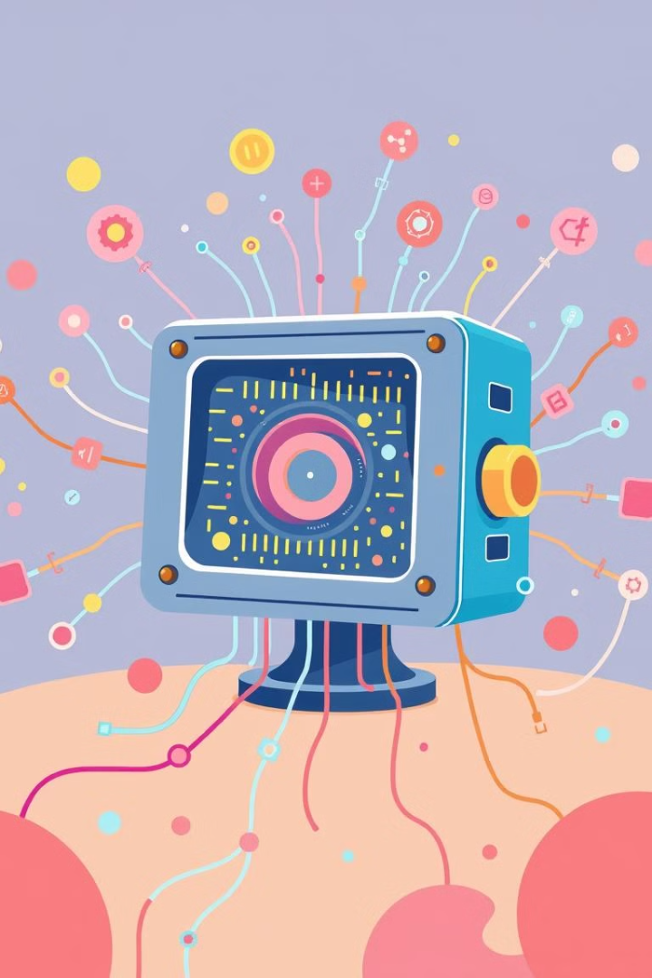
Core Concepts of Quantum Computing
1
Qubits vs. Bits
2
Quantum Gates
Qubit as 0, 1, or both simultaneously, unlike a bit. Entangled qubits are interconnected, measuring one instantly reveals the other's state.
Manipulating Qubits using quantum gates, analogous to logic gates in classical computing.
3
Quantum Algorithms
Harnessing quantum phenomena for exponential speedup in tasks like unstructured search or factoring large numbers.

Slide 4
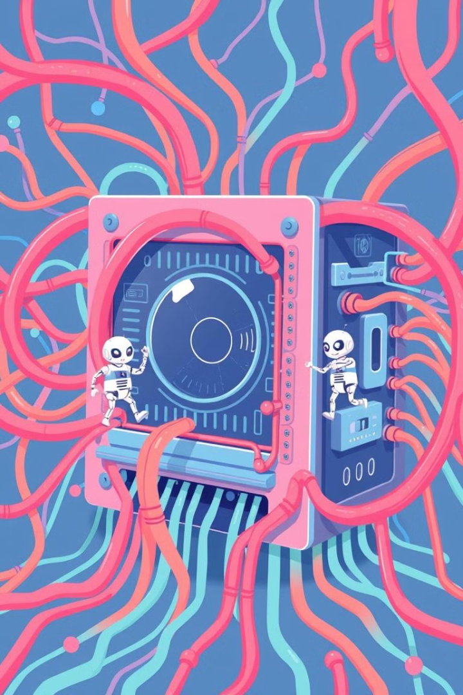
Advantages of Quantum Computing for AI
Exponential Speedup
Training large neural networks like GPT-3 can be significantly accelerated.
Enhanced Optimization
Finding optimal solutions in AI models using quantum annealing, improving performance.
Improved Pattern Recognition
Quantum machine learning algorithms enhance pattern recognition accuracy in certain datasets.
Handling Big Data
Quantum algorithms for dimensionality reduction and feature selection help process and analyze massive datasets.

Slide 5





Challenges and Limitations
Hardware Instability
Scalability
Algorithm Development
Quantum Software Development
Qubit decoherence due to environmental noise and the need for complex error correction codes.
Building large-scale quantum computers with thousands or millions of qubits is a major challenge.
Designing quantum algorithms for specific AI tasks is a bottleneck, with limited availability.
Requires specialized expertise and advanced tools for quantum software development.

Slide 6

Use Cases in AI
Quantum Machine Learning
1
Enhancing classification and regression tasks using quantum algorithms like QSVMs and QNNs.
2
Quantum Optimization
Solving complex optimization problems in AI, such as portfolio optimization and fraud detection.
Quantum Natural Language Processing
3
Accelerating NLP tasks like sentiment analysis and machine translation.
4
Quantum Robotics
Improving robot perception and decision-making, including path planning for autonomous vehicles.

Slide 7
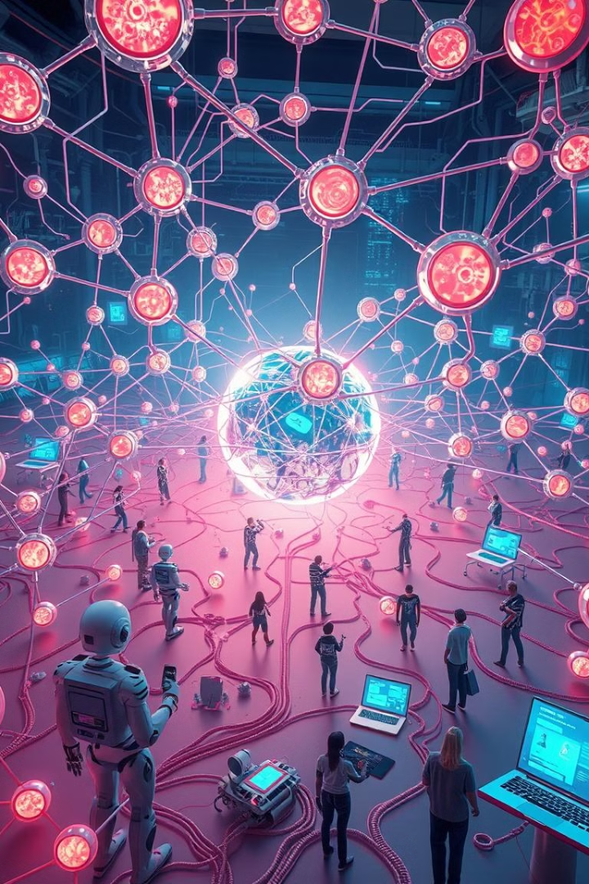




The Future of Quantum AI
Near-term Applications
Hybrid quantum-classical algorithms leveraging the strengths of both quantum and classical computers.
Long-term Vision
Fault-tolerant quantum computers revolutionizing AI, leading to breakthroughs in various industries.
Investment and Research
Growing interest from governments and industry, with significant investments and active participation from tech giants and startups.
Impact on Society
Transforming various industries and aspects of life, revolutionizing healthcare, finance, and scientific research.

Slide 8
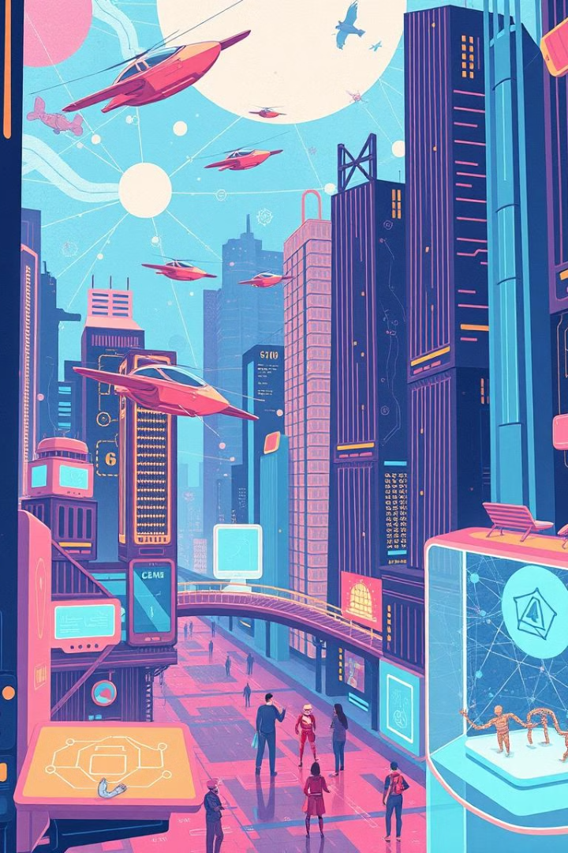
Conclusion
Quantum Computing: A paradigm shift in computation. Quantum AI: Unleashing new possibilities in artificial intelligence. The future is quantum: Prepare for the quantum revolution in AI!

